Slide 1
MDST Earthquake
Group 5
Oliver Gao, Alex Hu, Filip Saulean, Tiffany Tan

Slide 2
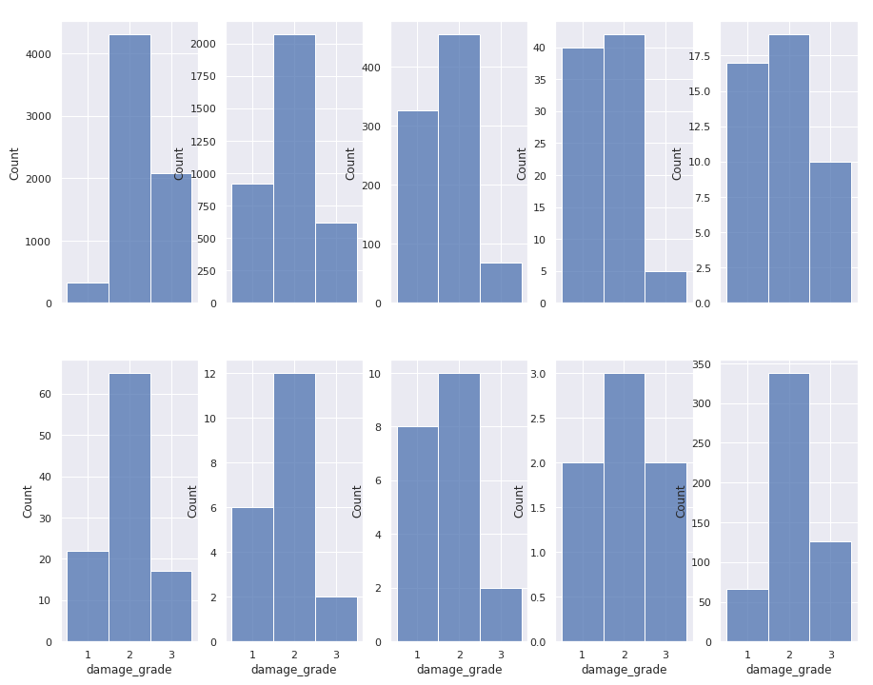
Damage Grade
In order left to right: agriculture, hotel, rental, institution, school, industry, health post, gov office, police, other

Slide 3
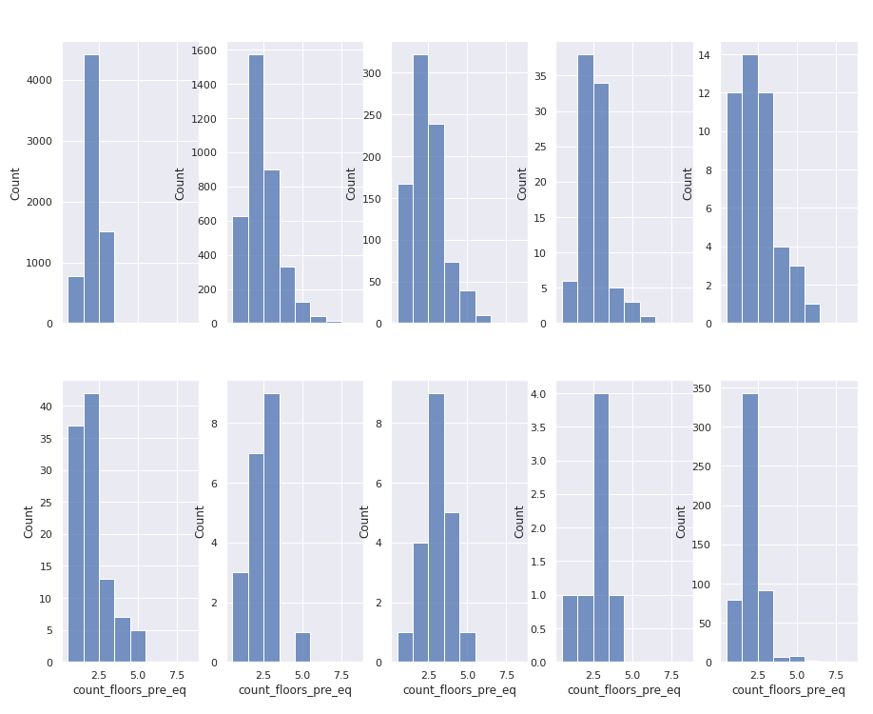
Floors Pre- Earthquake
In order left to right: agriculture, hotel, rental, institution, school, industry, health post, gov office, police, other

Slide 4
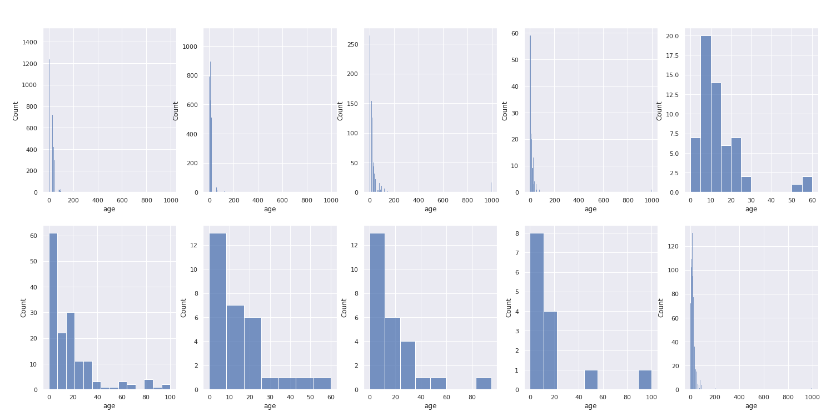
Age
In order left to right: agriculture, hotel, rental, institution, school, industry, health post, gov office, police, other.

Slide 5
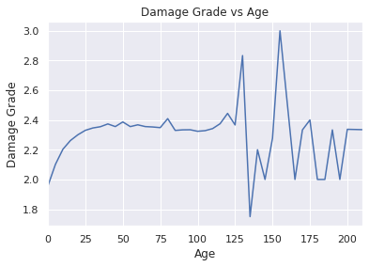
Damage Grade vs Age

Slide 6
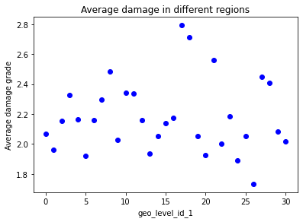
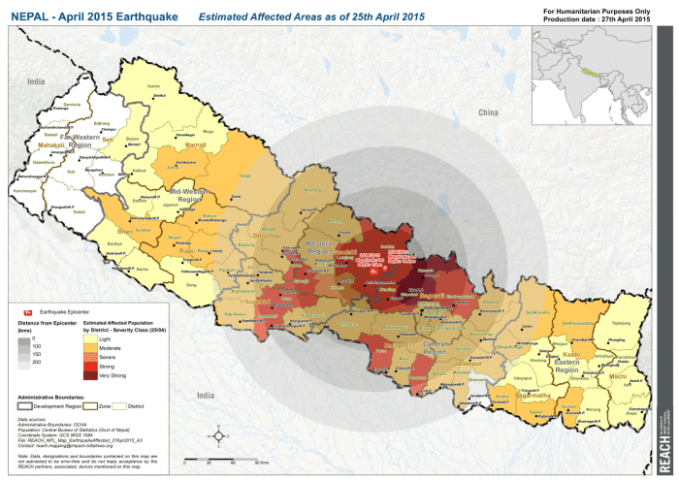
Geographic Region (level 1)
Strongest shaking occurs at earthquake’s epicenter
Epicenter is near geo_id 17 & 18 ??
Probably not
large proportion (0.9, 0.7) of buildings are mud_mortar_stone (weak)

Slide 7
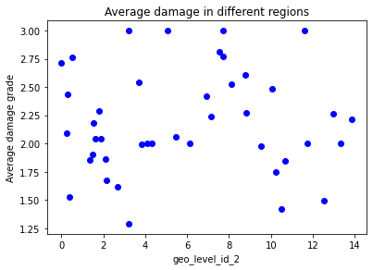
Geographic Region (level 2)
Tried to exclude regions with large proportions of mud_mortar_stone
Interesting finding:
some regions only have one building in them
others have 100+

Slide 8
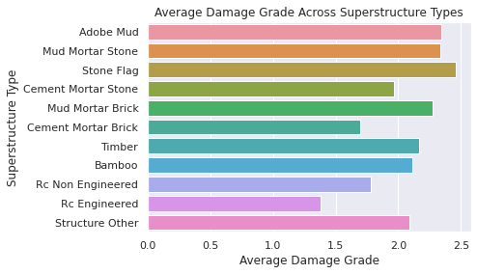
Superstructure

Slide 9
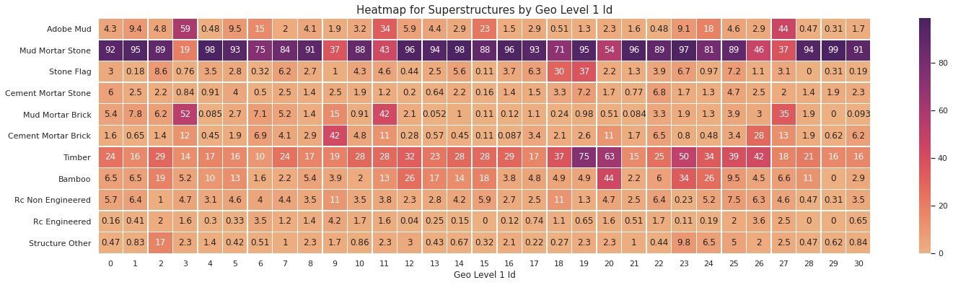
Superstructures by Geo Id (Level 1)

Slide 10
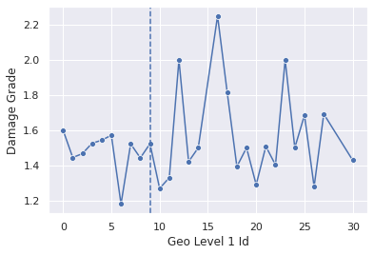
Damage Grade For RC Engineered

Slide 11
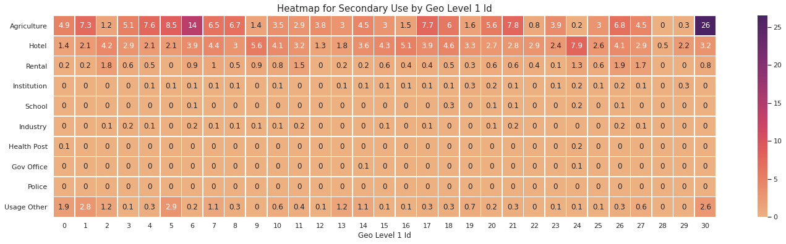
Secondary Jse by Geo Id (Level 1)

Slide 12
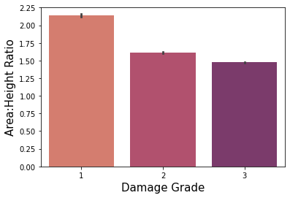
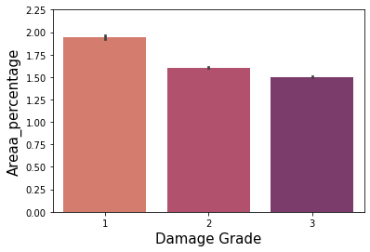
Area and Height
Area to Height Ratio
“fatter” buildings suffered less damage than “skinnier” ones
shows larger differences than area_percentage alone

Slide 13
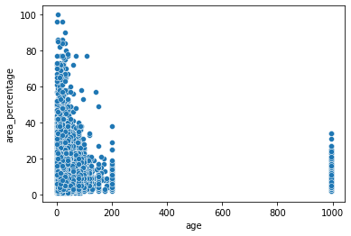
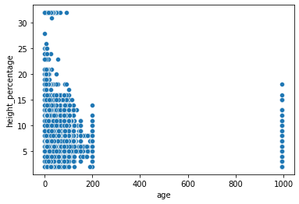
Age vs. Area and Height

Slide 14
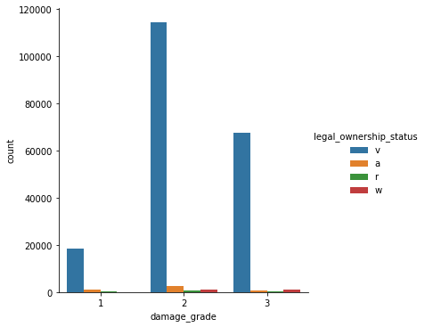
Legal Ownership Status
Different types of ownership (in general)
sole ownership
joint tenancy
corporation

Slide 15
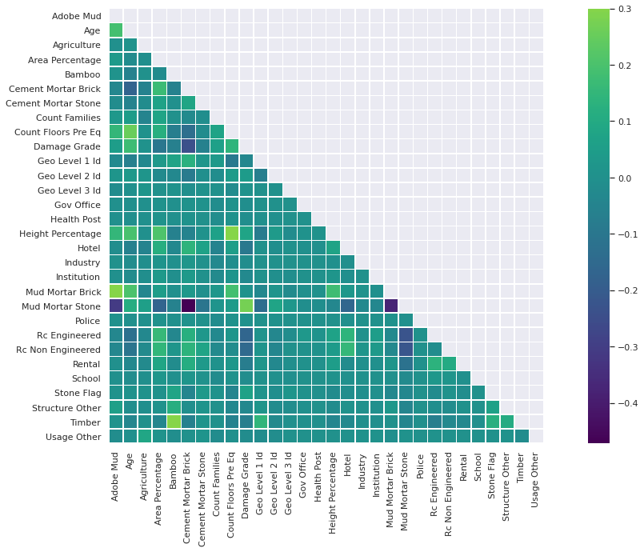
Correlation Matrix

Slide 16
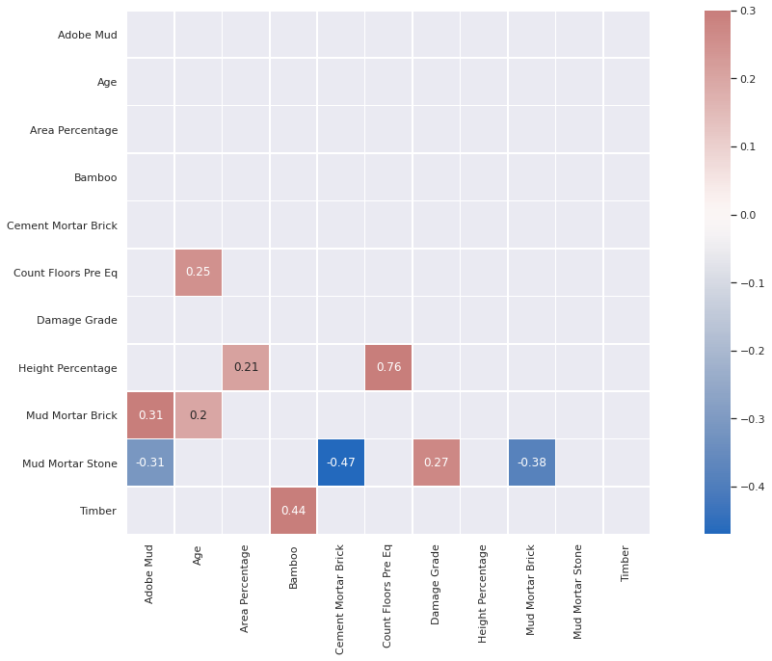
Correlation Matrix with extreme values noted

Slide 17
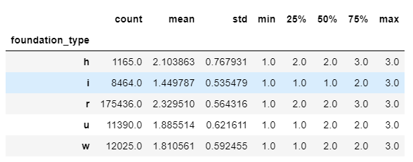
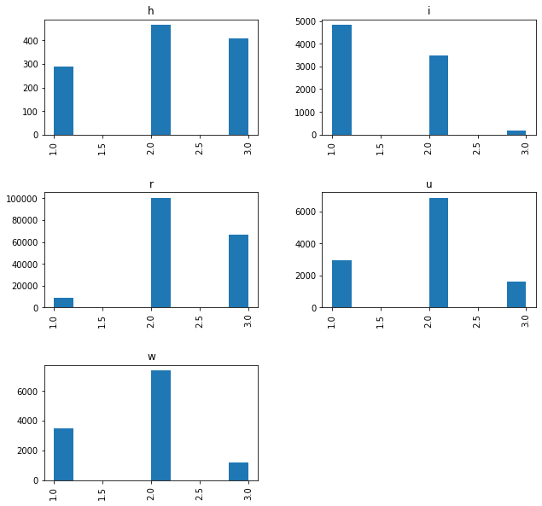
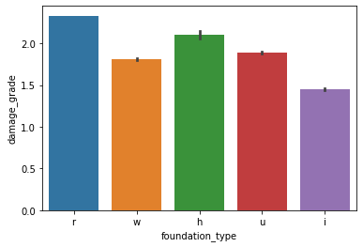
Foundation Type

Slide 18
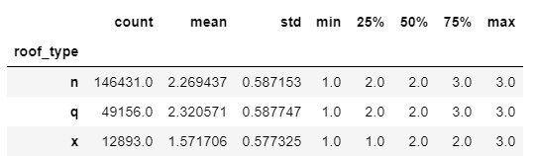
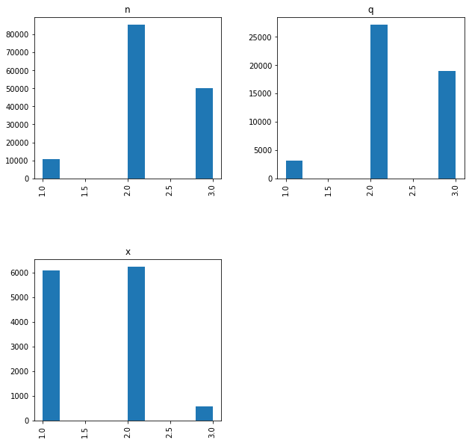
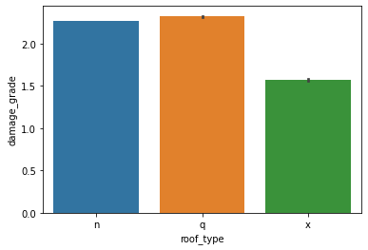
Roof Type

Slide 19
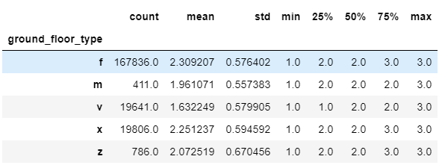
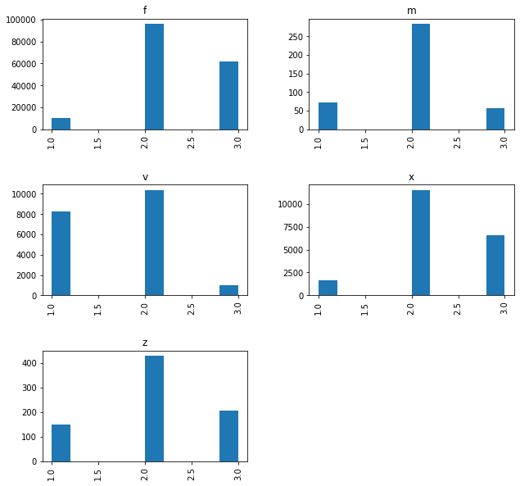
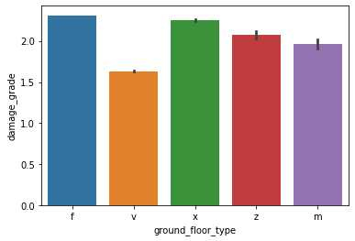
Floor Type

Slide 20
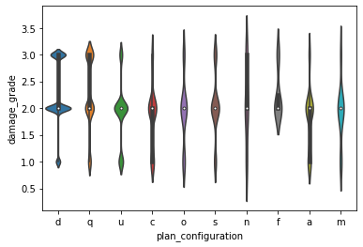
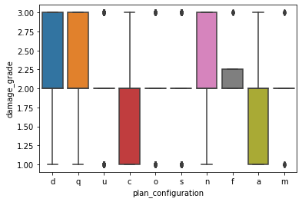
Plan Configuration

